Slide 1
^{Great Britain}
^{Tourism Survey}
^{December 2018}

Slide 2
Long term trends: How to compare data collected from January 2016 onwards with data collected in December 2015 and before
The introduction of a new data processing approach in January 2016 had an impact, albeit small, on the reported estimates for trips, nights and expenditure.
This change also impacted trends and the ability to conduct long-term analysis. Therefore caution should be taken when comparing data from January 2016 onwards with data in December 2015 and before. Where relevant, trend breaks have been clearly marked either with asterisk or a dotted line to indicate where users should be cautious.
As 2016 and 2017 use the same data processing approach, 2017 data can be compared to 2016 data without any concern. Similarly collected any data before December 2015 can be compared with any other data collected prior to December 2015 without any concern.
For more information please see: https://www.visitbritain.org/about-gbts-and-gbdvs

Slide 3
Summary of Results GB And England
 | Headlines
December 2018
 | There were 10.4 million domestic overnight trips in GB in December 2018, which is down -4% from 10.8 million trips in December 2017. Expenditure increased by +3% to £1.8 billion, while the number of nights decreased by -6% to 33.0 million.
 | There were 9.1 million domestic overnight trips to England in December 2018, down by -2% on the same month last year. Spend increased by +7% to £1.5 billion, and bednights decreased by -6% to 27.9 million.
YEAR-TO-DATE
 | In the year to December 2018, GB trips were down by -2% at 118.5 million, compared to 120.7 million in the same period in 2017. Nights remained unchanged for the year-to-date at 370.3 million, while spend increased for the year to date by +1% to £23.9 billion.
 | In the year to December 2018, trips to England decreased by -3% to 97.4 million, compared to 100.6 million in the same period in 2017. Nights were down by -2% at 294.3 million, while spend increased by +1% for the year to date to £19.3 billion.
 | Context
 | December started mild and changeable with westerly winds, and this pattern continued until the 9^{th,} followed by a colder quieter spell between the 10th and 14th, Storm Deirdre brought widespread freezing rain on the 15th, The mild changeable weather returned from the 16th to 23rd. From the 24th onwards it was somewhat more settled.
Trips
Nights
Spend
-4%
-6%
+3%
-2%
-6%
+7%
-2%
0%
+1%
-3%
-2%
+1%
Weather

Slide 4
Summary of Results England
YEAR-TO-DATE (January-December 2018) |  |  |  |  | Trip Characteristics
 | Trips | Nights | Spend |  | PURPOSE
 |  |  |  |  | HOLIDAY TRIPS in England from January to December 2018 decreased by -4% compared to the same period in 2017, with 45.2 million trips recorded. Expenditure increased by 1% at £11.1 billion, while nights decreased by -4% to 151.1 million.
 |  |  |  |  | VISITS TO FRIENDS AND RELATIVES decreased by -3% to 35.5 million, with bednights up by +1% and expenditure decreasing -1%. Non-holiday VFR trip volume decreased by -3% and holiday VFR trips decreased by -3%.
 |  |  |  |  | BUSINESS trips decreased for the January to December period by -2% to 13.9 million. Nights increased by +1%, whilst spend increased compared to the same period in 2017, by +7%.
-4%
-4%
+1%
-3%
+1%
-1%
-2%
+1%
+7%
 |  |  |  | TRIP TAKERS
 |  |  |  | The 55+ age group were the only age group to increase in trips of all purposes for Jan-Dec compared to the same time in 2017, increasing by +1%. The only social income group to increase were the C1 group, increasing by +1%.
 |  |  |  | DESTINATION TYPE
 |  |  |  | The North East and East Midlands saw the greatest increases in trips of all purposes taken during the Jan-Dec period, increasing in trip volume by +11% and +3% respectively. For the different destination types, large cities / large towns increased in trip volumes by +2%, whilst all other destination types decreased.
55+
C1
+1%
+1%
North East
East Midlands
Large city /
large town
+11%
+3%
+2%

Slide 5
Context Other Surveys
 |  |  |  |  |  | Overseas Travel by UK Residents International Passenger Survey
 | December 2018 |  | Jan – Dec 2018
 | Trips | Spend | Trips | Spend
 |  |  |  |  |  | In December, UK residents’ trips abroad decreased by -5% compared to the same month in 2017, whilst expenditure on these trips increased by +9%. For the year to date, overseas trips were down by -1%. Expenditure was up by +2% compared to Jan-Dec 2017.
 |  |  |  |  |  | Other Tourism Surveys
December 18 | Room |  | Bedspace |  |  | OCCUPANCY
 |  |  |  |  |  | Room occupancy in England in December was up by +3% to 72%, whilst bedspace occupancy increased by +1% to 52%.
Jan-Dec 18 | Volume |  | Spend |  |  | DAY VISITS
 |  |  |  |  |  | The volume of tourism day visits in England in the period January to December 2018 decreased by -5% to 1.4 billion. The value of those visits increased by +4% to £53.0 billion.
Christmas / New Year 18 | Attractions |  | Accommodation |  |  | TOURISM BUSINESS MONITOR
 |  |  |  |  |  | Over the Christmas and New Year period 2018, accommodation business reported a similar performance to how they fared in 2018 as a whole – 43% of businesses saw increased visitor numbers whilst 17% saw a decline in visitors vs. the same period in 2017. For attractions, over half (56%) reported increased visitor numbers over Christmas / New Year, whilst 16% reported decreased visitor numbers, vs. the same time in 2017.
-5%
+9%
-1%
+2%
+3%
+2%
+1%
-5%
+4%



Slide 6
Headline Data GB and England
Volume and spend (2017 vs 2018)
England
a
2017
2018
⬅➔
-2%
-8%
-3%
⬅➔
+7%
-1%
+1%
GB
a
2017
2018
⬅➔
-4%
-9%
-2%
⬅➔
+3%
-6%
+1%
⬅➔ % change vs 2017

Slide 7
Trips England
Volume of trips (millions) (2017 vs 2018)
2017
2018
2017
2018
2017
2018
2017
2018
a
a
a
a
a
a
a
a
All trips
Holiday trips
Business trips
VFR trips
⬅➔ | -2% | -4% | +16% | -4% |  | -8% | -7% | -20% | -4% |  | -3% | -4% | -2% | -3%
⬅➔ % change vs 2017

Slide 8
Nights England
Volume of nights (millions) (2017 vs 2018)
2017
2018
2017
2018
2017
2018
2017
2018
a
a
a
a
a
a
a
a
All trips
Holiday trips
Business trips
VFR trips
⬅➔ | -6% | +4% | -3% | -10% |  | -7% | -6% | -13% | -7% |  | -2% | -4% | +1% | +1%
⬅➔ % change vs 2017

Slide 9
Spend England
Expenditure (£m) (2017 vs 2018)
2017
2018
2017
2018
2017
2018
2017
2018
a
a
a
a
a
a
a
a
All trips
Holiday trips
Business trips
VFR trips
⬅➔ | +7% | +11% | +22% | -4% |  | -1% | -5% | +5% | 0% |  | +1% | +1% | +7% | -1%
⬅➔ % change vs 2017
GBTS December 2018 Published 5th April 2019

Slide 10
Long Term Trends by Month GB
2006-2018 (millions)*
*Break in time series 2015-2016 – see slide 2
**Due to a data collection issue, separate December 2014 data is not available

Slide 11
Long Term Trends, Year-to-Year England
All Trips
Holiday Trips
Business Trips
VFR Trips
*Break in time series 2015-2016 – see slide 2

Slide 12
Rolling 12 Month Trendlines England
All trips and spend
*Break in time series 2015-2016 – see slide 2

Slide 13
Rolling 12 Month Trendlines England
Trips by purpose (millions)*
Holiday trips
Business trips
VFR trips
*Break in time series 2015-2016 – see slide 2

Slide 14
Rolling 12 Month Trendlines England
Spend by purpose (£millions)*
Holiday trips
Business trips
VFR trips
*Break in time series 2015-2016 – see slide 2

Slide 15
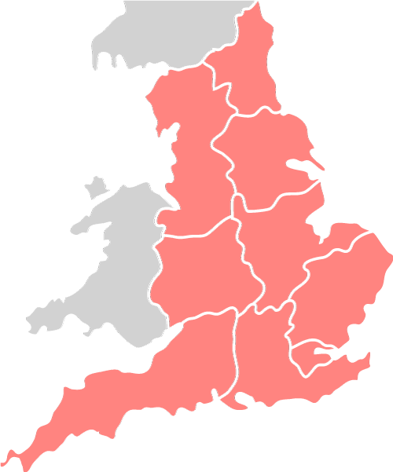
Regional Analysis England
Trip characteristics – region (YTD 2017 vs YTD 2018)
Trips
(Millions)
Nights
(Millions)
Spend
(£ millions)
North East
YTD
2017 | 2018 | ⬅➔
3.6 | 4.0 | +11%
10.9 | 12.8 | +18%
680 | 759 | +12%
Yorkshire & Humber
YTD
2017 | 2018 | ⬅➔
10.7 | 10.5 | -2%
29.3 | 29.9 | +2%
1745 | 1745 | 0%
North West
YTD
2017 | 2018 | ⬅➔
13.7 | 13.3 | -3%
37.8 | 34.1 | -10%
2733 | 2677 | -2%
East Midlands
YTD
2017 | 2018 | ⬅➔
7.5 | 7.7 | +3%
21.7 | 21.6 | 0%
1049 | 1191 | +14%
West Midlands
YTD
2017 | 2018 | ⬅➔
7.9 | 7.7 | -2%
18.4 | 20.0 | +9%
1225 | 1324 | +8%
South West
YTD
2017 | 2018 | ⬅➔
20.6 | 19.1 | -7%
76.8 | 73.3 | -5%
4456 | 4334 | -3%
South East
YTD
2017 | 2018 | ⬅➔
16.1 | 16.2 | +1%
43.0 | 46.0 | +7%
2709 | 2705 | 0%
London
YTD
2017 | 2018 | ⬅➔
12.1 | 11.9 | -2%
27.8 | 27.9 | 0%
2689 | 2985 | +11%
East
YTD
2017 | 2018 | ⬅➔
9.7 | 8.7 | -10%
32.6 | 27.7 | -15%
1710 | 1554 | -9%

Slide 16
UK Outbound Travel 2018 (International Passenger Survey)
Total volume (millions) and spend (£m)
2017
2018
2017
2018
a
a
a
a
Trips
Spend
⬅➔ | -5% | +9% |  | -1% | +7% |  | -1% | +2%
⬅➔ % change vs 2017

Slide 17
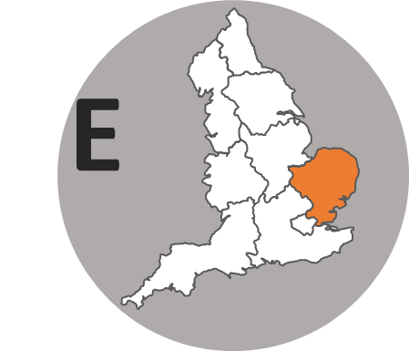
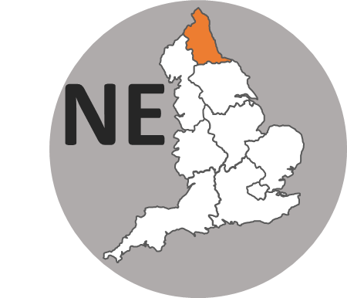
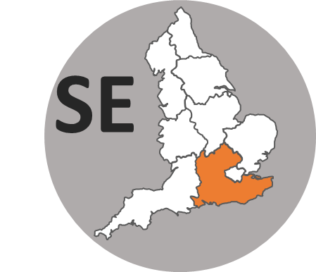
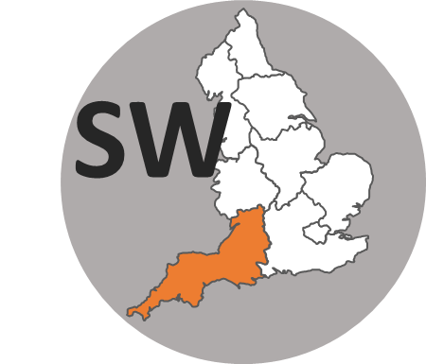
Appendix: Domestic Tourism England
Trip characteristics (Year-To-Date: Jan-Dec 2018)
PURPOSE
 |  | Pure Holiday | 1-3 nights | +4 nights | VFR (on holiday) | Holiday (total) | VFR (non-holiday) | VFR (total) | Business
TRIPS Millions | 2017 | 47.2 | 31.4 | 15.8 | 25.0 | 72.2 | 11.6 | 36.6 | 14.2
 | 2018 | 45.2 | 29.7 | 15.5 | 24.2 | 69.4 | 11.3 | 35.5 | 13.9
 | ⬅➔ | -4% | -5% | -2% | -3% | -4% | -3% | -3% | -2%
NIGHTS Millions | 2017 | 157.8 | 59.5 | 96.7 | 74.6 | 232.4 | 27.7 | 102.3 | 31.6
 | 2018 | 151.1 | 56.8 | 94.3 | 75.1 | 226.2 | 28.6 | 103.6 | 31.8
 | ⬅➔ | -4% | -5% | -3% | +1% | -3% | +3% | +1% | +1%
SPEND £Millions | 2017 | 11022 | 5853 | 5166 | 2738 | 13761 | 1213 | 3951 | 3557
 | 2018 | 11101 | 5903 | 5197 | 2753 | 13850 | 1156 | 3907 | 3815
 | ⬅➔ | +1% | +1% | +1% | +1% | +1% | -5% | -1% | +7%
 | Unwtd Trips | 6249 | 3924 | 2323 | 3305 | 9551 | 1524 | 4826 | 1438
REGION
 |  | West Midlands | East of England | East Midlands | London | North West | North East | South East | South West | Yorkshire & Humber
TRIPS Millions | 2017 | 7.9 | 9.7 | 7.5 | 12.1 | 13.7 | 3.6 | 16.1 | 20.6 | 10.7
 | 2018 | 7.7 | 8.7 | 7.7 | 11.9 | 13.3 | 4.0 | 16.2 | 19.1 | 10.5
 | ⬅➔ | -2% | -10% | +3% | -2% | -3% | +11% | +1% | -7% | -2%
NIGHTS Millions | 2017 | 18.4 | 32.6 | 21.7 | 27.8 | 37.8 | 10.9 | 43.0 | 76.8 | 29.3
 | 2018 | 20.0 | 27.7 | 21.6 | 27.9 | 34.1 | 12.8 | 46.0 | 73.3 | 29.9
 | ⬅➔ | +9% | -15% | 0% | 0% | -10% | +18% | +7% | -5% | +2%
SPEND £Millions | 2017 | 1225 | 1710 | 1049 | 2689 | 2733 | 680 | 2709 | 4456 | 1745
 | 2018 | 1324 | 1554 | 1191 | 2985 | 2677 | 759 | 2705 | 4334 | 1745
 | ⬅➔ | +8% | -9% | +14% | +11% | -2% | +12% | 0% | -3% | 0%
 | Unwtd Trips | 981 | 1171 | 1041 | 1477 | 1768 | 516 | 2154 | 2623 | 1362
⬅➔ % change vs 2017

Slide 18
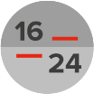
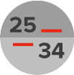
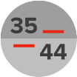
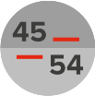
Appendix: Domestic Tourism England
Trip characteristics (Year-To-Date: Jan-Dec 2018)
LOCATION TYPE
 |  | Seaside | Large City/Town | Small Town | Countryside /Village
TRIPS Millions | 2017 | 22.7 | 42.6 | 19.1 | 17.1
 | 2018 | 21.2 | 43.5 | 18.1 | 15.9
 | ⬅➔ | -7% | +2% | -5% | -7%
NIGHTS Millions | 2017 | 86.7 | 100.7 | 52.9 | 55.2
 | 2018 | 81.4 | 110.4 | 49.7 | 49.6
 | ⬅➔ | -6% | +10% | -6% | -10%
SPEND £Millions | 2017 | 4892 | 7964 | 2902 | 3047
 | 2018 | 4752 | 8630 | 2952 | 2816
 | ⬅➔ | -3% | +8% | +2% | -8%
 | Unwtd Trips | 3118 | 5428 | 2362 | 2120
SOCIAL GRADE
 |  | AB | C1 | C2 | DE
TRIPS 000s | 2017 | 43.0 | 30.8 | 15.6 | 11.2
 | 2018 | 41.0 | 31.0 | 14.5 | 10.9
 | ⬅➔ | -5% | +1% | -7% | -3%
NIGHTS 000s | 2017 | 117.7 | 94.4 | 49.2 | 38.0
 | 2018 | 112.5 | 96.3 | 46.4 | 39.0
 | ⬅➔ | -4% | +2% | -6% | +3%
SPEND £Millions | 2017 | 8559 | 5779 | 2842 | 1867
 | 2018 | 8596 | 5915 | 2964 | 1851
 | ⬅➔ | 0% | +2% | +4% | -1%
 | Unwtd Trips | 4279 | 4190 | 2218 | 2171
AGE
 |  | 16-24 | 25-34 | 35-44 | 44-54 | 55+
TRIPS Millions | 2017 | 10.6 | 18.0 | 19.5 | 19.9 | 32.6
 | 2018 | 10.1 | 16.0 | 19.2 | 19.0 | 33.0
 | ⬅➔ | -6% | -11% | -1% | -4% | +1%
NIGHTS Millions | 2017 | 36.3 | 47.7 | 52.7 | 55.3 | 107.5
 | 2018 | 34.3 | 44.5 | 56.6 | 51.0 | 107.9
 | ⬅➔ | -5% | -7% | +7% | -8% | +0%
SPEND £Millions | 2017 | 1777 | 3361 | 3298 | 4081 | 6531
 | 2018 | 1944 | 2936 | 3477 | 4141 | 6822
 | ⬅➔ | +9% | -13% | +5% | +1% | +4%
 | Unwtd Trips | 1268 | 2051 | 2403 | 2090 | 5050
CHILDREN IN H/H
 |  | Any | None
TRIPS 000s | 2017 | 33.8 | 66.8
 | 2018 | 32.3 | 65.1
 | ⬅➔ | -4% | -3%
NIGHTS 000s | 2017 | 97.6 | 201.8
 | 2018 | 97.5 | 196.8
 | ⬅➔ | 0% | -2%
SPEND £Millions | 2017 | 5496 | 13553
 | 2018 | 5733 | 13593
 | ⬅➔ | +4% | +0%
 | Unwtd Trips | 4293 | 8562
⬅➔ % change vs 2017

Slide 19
Appendix: Domestic Tourism England
Trip characteristics (Year-To-Date: Jan-Dec 2018)
Accommodation
 |  | Commercial Accommodation | (a) Serviced accom | (b) Hotel/motel/guesthouse | (c) Bed & Breakfast | Total self-catering rented | (a) Camping & Caravanning (inc. owned caravans) | (b) Other self-catering rented | Hostels* | Own home/friends'/ relatives'
TRIPS Millions | 2017 | 62.9 | 43.1 | 36.7 | 4.5 | 19.8 | 11.8 | 8.9 | 0.6 | 35.7
 | 2018 | 60.2 | 42.0 | 36.2 | 3.9 | 16.4 | 10.5 | 8.3 | 0.3 | 35.6
 | ⬅➔ | -4% | -2% | -1% | -13% | -17% | -11% | -7% | -43% | 0%
NIGHTS Millions | 2017 | 181.2 | 92.4 | 75.4 | 10.3 | 87.0 | 50.1 | 39.4 | 1.6 | 106.6
 | 2018 | 175.6 | 93.4 | 77.4 | 9.0 | 74.4 | 45.4 | 37.0 | 0.7 | 107.1
 | ⬅➔ | -3% | +1% | +3% | -12% | -14% | -9% | -6% | -53% | 0%
SPEND £millions | 2017 | 15263 | 10703 | 9097 | 1065 | 4607 | 1758 | 2918 | 120 | 3133
 | 2018 | 15565 | 11105 | 9667 | 861 | 4285 | 1828 | 2750 | 74 | 3160
 | ⬅➔ | +2% | +4% | +6% | -19% | -7% | +4% | -6% | -38% | +1%
Unwtd Trips |  | 7813 | 5300 | 4524 | 511 | 2331 | 1524 | 1111 | 42 | 4798
*caution small sample size ⬅➔ % change vs 2017

Slide 20
Appendix: Domestic Tourism England
Year to date average trip length, spend/night, spend/trip*
 | All Tourism |  |  |  |  |  | Holidays |  |  |  |  |  | Business |  |  |  |  |  | VFR
 | 2013 | 2014 | 2015* | 2016 | 2017 | 2018 | 2013 | 2014 | 2015* | 2016 | 2017 | 2018 | 2013 | 2014 | 2015* | 2016 | 2017 | 2018 | 2013 | 2014 | 2015* | 2016 | 2017 | 2018
Trip Length | 2.92 | 2.95 | 2.91 | 2.90 | 2.98 | 3.02 | 3.33 | 3.37 | 3.35 | 3.29 | 3.34 | 3.34 | 2.13 | 2.29 | 2.17 | 2.24 | 2.23 | 2.28 | 2.77 | 2.71 | 2.74 | 2.66 | 2.80 | 2.92
Spend Per Night | £63 | £66 | £65 | £64 | £64 | £66 | £70 | £73 | £73 | £71 | £70 | £73 | £113 | £113 | £111 | £115 | £112 | £120 | £38 | £42 | £42 | £40 | £39 | £38
Spend Per Trip | £184 | £195 | £191 | £186 | £189 | £198 | £233 | £247 | £245 | £233 | £233 | £245 | £242 | £258 | £241 | £257 | £251 | £274 | £107 | £113 | £115 | £106 | £108 | £110
*Break in time series 2015-2016 – see slide 2

Slide 21
Note about these results:
The GB Tourism Survey is a survey of British residents, in which 2000 respondents are interviewed each week, making a total of 100,000 each year.
Any respondent having taken one or more overnight trips in the previous 4 week period is asked to describe the details of trips taken. Each year, data from around 17,000 trips is collected, and this is subsequently grossed up to provide population estimates. Full details of the survey methodology can be found at: https://www.visitbritain.org/archive-great-britain-tourism-survey-overnight-data
On an annual basis, the survey is extremely robust, with a confidence level for England data at +/- 3% at the 95% level for the number of trips and nights measured, and +/- 4% for the expenditure figure.
For shorter time periods and for other subsets of the data such as region or trip purpose, the margin of error is wider – guidance on confidence intervals at national and regional level for annual and quarterly data is provided on the next page.
For any questions about data interpretation, please contact VEResearch@visitengland.org
No part of this publication may be reproduced for commercial purposes without the permission of VisitEngland. Extracts may be quoted if the source is acknowledged.
Users wishing to include results from this survey within a press release should contact Charlotte Sanders in the VisitEngland Press Office charlotte.sanders@visitengland.org for review prior to external release.

Slide 22
GB Domestic Tourism: Confidence Limits at the 95% level
 | TRIPS (millions) |  | BEDNIGHTS (millions) |  | EXPENDITURE (£ millions)
Destination: | Single Quarter | Annual | Single Quarter | Annual | Single Quarter | Annual
GB Total | 5.8% | 2.6% | 7.0% | 3.1% | 7.4% | 3.5%
England Total | 6.2% | 2.8% | 7.3% | 3.3% | 8.1% | 3.8%
East | 17.1% | 7.8% | 19.0% | 9.7% | 22.4% | 11.2%
East Midlands | 17.7% | 8.3% | 21.4% | 10.3% | 23.2% | 11.2%
London | 15.9% | 7.5% | 26.5% | 11.6% | 24.9% | 11.4%
North East | 24.6% | 11.3% | 29.4% | 13.6% | 37.1% | 17.6%
North West | 12.9% | 6.2% | 16.3% | 7.5% | 17.4% | 8.4%
South East | 12.8% | 6.0% | 17.2% | 7.7% | 18.2% | 8.4%
South West | 12.7% | 5.5% | 13.4% | 6.4% | 16.4% | 7.9%
West Midlands | 16.6% | 8.1% | 19.1% | 10.4% | 21.8% | 11.8%
Yorks & Humb | 15.7% | 7.2% | 19.3% | 9.4% | 20.8% | 10.5%
Based on Quarter 4

