Slide 1
Accessible & Inclusive Tourism Slides
17 slides
For use as part of staff induction and refresher training
An introduction to disability and providing access for all
2 activities to facilitate discussion
Detailed supporting notes for the trainer to follow.
Credit: VisitEngland/Pawel Libera
Notes:
1 in 4 people have an ‘activity limiting’ health condition or impairment.
To be able to confidently serve disabled customers, staff in the tourism industry need to become disability aware.
Becoming disability aware will mean that staff understand specific visible and hidden disabilities, appropriate language to use and how to provide an accessible service.
With these skills, they can deliver excellent customer service to all guests.
These training slides can be used as part of your induction training as an introduction to disability and the importance of providing a welcoming and accessible experience to everyone.
A natural next step is to provide staff with disability awareness training. There are a number of courses specifically for those working in the tourism industry. Find out more at visitengland.org/access.

Slide 2
As a tourism business we need to be aware of the ‘Purple Pound’
There are 16 million disabled people in the UK
Disability affects 1 in 4 people in the UK
75% of disabled people have left a business due to poor disability awareness
Accessible tourism is worth £14.6 billion in England annually, with £6.7 billion spent on overnight stays.
Notes:
The Purple Pound is a new term used to describe the spend of disabled people.
People often under estimate the number of disabled people, this is due to people not realising how broad disability is and that a lot of disability cannot be seen.
There are currently 16 million disabled people in the UK alone (24% of population). Disability impacts on even more people when you account for disabled people’s family and friends.
As a tourism business we need to be aware of the spending power and influence of disabled people.
The total expenditure of people with health conditions and impairments - and their travelling companions - on tourism in England is a staggering £14.6 billion a year.
Inbound visitor spending by this group was £0.5 billion in 2023
Domestic overnight visitor spending by this group was £6.7 billion in 12 months to June 2023
Day visitor spending by this group was £7.4 billion in in 12 months to June 2023.
Source: Great Britain Day Visitor Survey (July 2022 to June 2023), Great Britain Tourism Survey (July 2022 to June 2023) and the International Passenger Survey 2018.
70% of disabled people will not return to a business after receiving poor customer service (Purple, 2022)
75% of disabled people and their families said that they had left a shop or business because of poor disability awareness or understanding meaning £1.8bn per month is being lost. Source:
Walkaway Pound Report July 2014-June 2015

Slide 3
1 in 4 domestic trips in the UK are made by over 55s …
Disability and Age
12.4 million people in the UK are over 65
By 2041 this will have increased to 1 in 4
The older we get the more likely we are to acquire an impairment
Notes:
The impact of accessibility is only going to increase due to the UK and world’s ageing population.
In 2022, 1 in 4 domestic holiday trips in England were made by over 55s [Source: Great Britain Tourism Survey]
12.4 million people in Great Britain are currently over 65, equating to almost 1 in 5 of the population. By 2041 this will have increased to 1 in 4.
All of this is significant as the older we get the more likely we are to acquire a disability.
Source: ONS
Added to this older people are more likely to have temporary accessibility concerns, significant again as 1 in 3 domestic trips in the UK are made by over 55s and this is increasing.

Slide 4
What is disability?
The term ‘disability’ covers a really wide
range of impairments.
An impairment …
Can be physical or mental
Will last more than 12 months
Impact on everyday activities
Remember …
A lot of disability is unseen
Only a small percentage of disabled people are wheelchair users.
Credit: VisitEngland/Pawel Libera
Notes:
So what is Disability...
It is important to remember the term ‘disability’ covers a really wide range of impairments.
An impairment may be physical or mental, but will be long term (last for more than 12 months) and have a substantial impact on the ability of someone to carry out day to day activities like washing, eating or walking.
Often when we think of disability we think of someone using a wheelchair. It is important to remember that wheelchair users only account for around 7% of disabled people.
Source: The Wheelchair Alliance report: In 2018-19, we estimate that there were around 780,000 users.
https://wheelchair-alliance.co.uk/wheelchair-research-report/
Family Resources Survey 2018/19 reported 21% disabled in England (11.6 million) (https://www.gov.uk/government/statistics/family-resources-survey-financial-year-201819 Table 4.4)
780,000 divided by 11,600000 x100 = 6.7%
A lot of disability is unseen – cancer, HIV, dementia and autism are all included within the definition of disability.

Slide 5
What is accessibility?
Accessibility involves removing barriers to provide positive experiences for all.
Customers with accessibility requirements have a range of differing impairments and health conditions.
Older market segments will….
typically include more people with health conditions and impairments.
be less likely to view themselves as disabled
still very much benefit from accessible features and facilities
Credit: VisitBritain/Peter Kindersley
Notes:
Accessibility involves removing barriers (whether physical, digital, relating to information and content, or attitudinal) to provide positive experiences for all.
Providing an accessible and inclusive experience is largely based on how you positively welcome and cater for customers with a range of differing impairments and health conditions.
Due to the correlation of impairment with ageing, senior market segments will typically include more people with health conditions and impairments.
Having acquired conditions later in life, these people are less likely to view themselves as disabled, but will still very much benefit from accessible features and facilities, and being able to share their requirements ahead of time.
The use of language is particularly important here; use terminology relating to accessibility rather than disability.

Slide 6
Social Model : What is a barrier?
Barriers
Steps
Negative attitudes
A long way to walk
No hearing loop
Loud noises
Nowhere to sit and rest
Notes:
The social model of disability is based on the idea that people are disabled not by their impairment but by the barriers in society. So if a wheelchair user can’t access a hotel because of a flight of steps, it is not their impairment that is disabling them it is the barrier – in this case the steps.
A barrier is something that stops a disabled person from accessing somewhere they want to go or having a positive experience.
A barrier could be something you can see – for example a step or a heavy door…
Or it could be something that is missing – for example a hearing loop or a chair to sit on…
It could equally be about attitude – so a member of staff ignoring someone or saying something offensive.
It is important to look at the service you offer to try and identify barriers and if possible remove them.

Slide 7
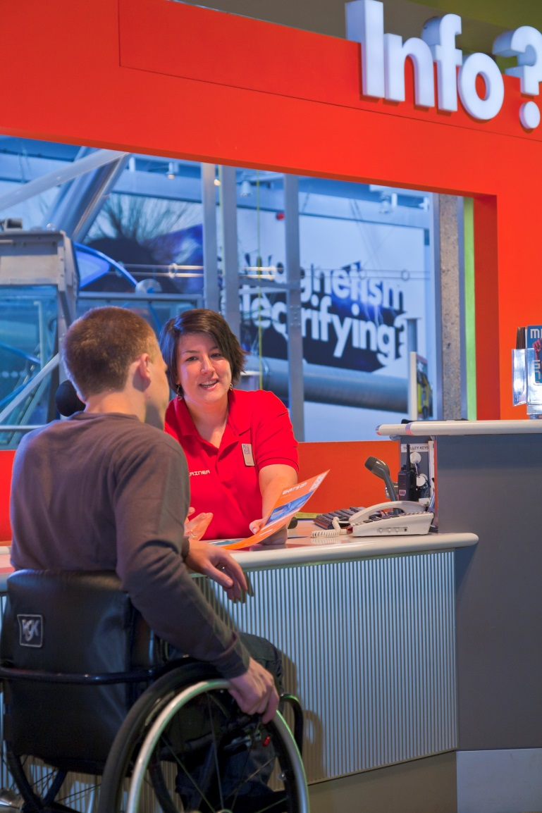
Providing a great service to all
Many of the tips provided are just part of great customer service -
Being welcoming
Thinking about how you can help
Being respectful
Being flexible
It is important to remember that everyone’s impairment is unique to them
And
If you feel someone may need assistance, ask
Credit: VisitEngland/Pawel Libera
Notes:
Providing a great service to disabled people and their families is in lots of ways simply about treating people as you would like to be treated.
It is about all the things that make people feel welcome and at ease, about ensuring people have the very best experience when they are with us.
A key thing to remember is that everyone is unique. Just because you have assisted one wheelchair user or guided someone with a visual impairment doesn’t mean the next person will necessarily have the same requirements.
It is crucial you treat everyone as an individual and let the person tell you how best you can assist them.
Regardless of who your disabled customers are travelling with, always address them personally and not only their companions.

Slide 8
How to offer assistance
Always ask if you feel someone needs help, but don’t be overbearing or offended if your help is turned down.
When providing assistance –
Listen carefully
Follow the person’s instructions
Respect boundaries
Keep thinking about customer service.
Credit: VisitEngland/Pawel Libera
Notes:
If someone looks like they may need assistance it is important to always offer it.
If it is turned down don’t be offended as many people will be happy to get on with things on their own or with the assistance of someone they have brought with them.
Remember, if people do want you to help that they are the best person to tell you how – always make sure you …. (read bullets)

Slide 9
Mobility impairment
If someone has a mobility impairment they may have difficulty using their limbs, with balance or coordination
They might use a wheelchair or stick but…
There may be no obvious signs
Things like steps and walking long distances could be a barrier.
What could you do to help?
Credit: VisitEngland/Pawel Libera
Notes:
Mobility impairment is a wide-ranging term. If someone has a mobility impairment it means that they may have difficulty using their limbs, with balance or coordination.
People may use a wheelchair or a walking stick, but equally it may not be visible that they have an impairment. This could include someone with Multiple Sclerosis or Arthritis.
We talked about barriers earlier – if you worked in a shop which has a step in to it what could you do to help someone who is walking with a stick?
(Use question to trigger discussion ….)
Ideas are –
Have a bell to attract attention of staff
Buy a ramp (if it would fit)
Keep aisles clear
Add handrails to either side of the step for support
Have some seating available, particularly where people may need to queue
Train staff in how best to provide assistance

Slide 10
Sensory impairment
Sensory impairment refers to losing your sight or hearing
Hearing loss is one of the most common impairments in the UK and linked to getting older
By 2035 it is estimated that there will be 14.2 million people in the UK with hearing loss
Just like mobility impairment, sensory impairment may not be obvious.
Credit: VisitEngland/Pawel Libera
Notes:
Sight loss is one of the most common causes of disability in the UK and linked to old age more than any other.
12 million adults in the UK are deaf, have hearing loss or tinnitus.
In the UK more than 40% of over 50s have hearing loss, rising to 70% of over 70s.
Source: RNID
People’s visual impairments can be very varied and they are not always obvious.
Think about walking around your venue – are there potential hazards for someone with a visual impairment?
Think about colour contrast between floors and walls, walls and doors as well as how steps are marked.
Hearing loss also impacts on a large number of people and also varies person to person. Hearing loss is very often hidden and you need to be aware of the different methods of communication people may use.

Slide 11
Who might the following help?
Hearing loop
Large print
Sign language
Assistance dogs
Notes:
Who do you think the following might help in regards to sensory impairment …
(Use as a trigger for discussion…)

Slide 12
Who might the following help? Answers
Hearing loop
Large print
Sign language
People with hearing loss
People with hearing loss
Assistance dogs
People with a visual impairment
People with a wide range of impairments
Notes:
(Talk through each answer ….)
A hearing loop is a device used by people with hearing aids, they come in many sizes – you can get one to use on a counter/desk to one that covers a theatre. It is important to know how they work and make sure people know they are there.
Sign language is a language in its own right used by Deaf people (people with severe hearing loss) – it is a language of the hands, body and face and has a completely different structure to English. Some people may only use sign language and will therefore need a sign language interpreter to communicate.
Large print is valuable to people with a visual impairment but may also be helpful to people with learning disabilities or difficulties. Large print is generally 16 to 18 point size in a clear font such as Arial.
Assistance dogs are used by people with lots of different impairments. We often think of Guide Dogs, but assistance dogs can help people with hearing loss, conditions such as epilepsy and by wheelchair users. It is crucial that we welcome assistance dogs as required under the Equality Act 2010.

Slide 13
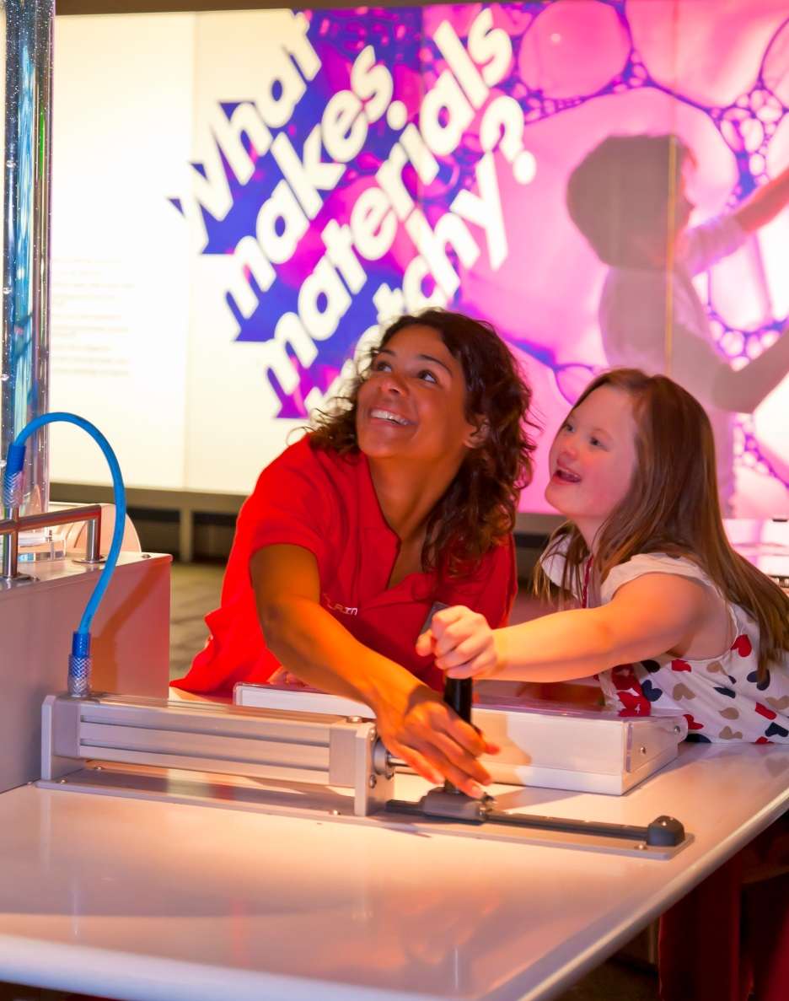
Learning disability
Caused by the way the brain develops before, during or soon after birth
There are 1.5 million people in the UK with a learning disability
It includes conditions like Down’s Syndrome
People with a learning disability find it harder to –
Learn
Understand
Communicate.
What could you do to help?
Credit: VisitEngland/Pawel Libera
Notes:
There are 1.5 million people in the UK with a learning disability [Source: Mencap]. The term is very broad and covers a range of conditions, as such people with learning disabilities will need varying levels of support. Some people may be very independent while other people may have multiple impairments which require people to support them.
It is very important never to assume what someone is able to do. If someone is having difficulty trying to communicate be patient, you should never ignore someone assuming that they cannot understand you.
Learning Disability - What could you do to help?
When communicating with someone with a learning disability attitudes are really important, be patient friendly and approachable.
Ensure you speak to the person, rather than anyone accompanying them.
If someone has a person helping them communicate, take your cue from them.
Try and use uncomplicated language.
Speak clearly and steady - if appropriate offer visual choices.

Slide 14
Autism
Autism can mean that people have difficulty understanding –
body language and holding conversations
other people’s emotions or reactions
the consequences of actions
Asperger's syndrome is a type of autism.
‘People with autism can find loud noises physically painful’
True or False?
What could you do to help?
Notes:
Autism is a developmental disability and is on a spectrum, which means it is very varied person to person.
Generally people with autism will have difficulty understanding… (read bullets)
Asperger’s syndrome which you may have heard of is a form of autism.
Often people think Asperger’s and Autism only affect children, but this is not the case. Autism is a lifelong condition.
It is important to not make assumptions if someone is - crying, screaming, rocking - as these may well be signs that someone has autism and is in distress.
(Ask question to gain feedback…)
Autism – What could you do to help?
Make sure you have the person’s attention before speaking them, but don’t necessarily expect full eye contact.
Say exactly what you mean, someone with autism may take things very literally.
Be patient and speak calmly, people with autism may find noise stressful and take longer to communicate.
Be aware that most people with autism do not have the social understanding of how they appear to others.

Slide 15
Dementia
Diseases that impact different parts of the brain
The most common type is Alzheimer’s disease
By 2040 1.6 million people in the UK will be living with dementia
A person with dementia might experience confusion and have issues with:
Day-to-day memory
Concentrating, planning and organising
Language
Orientation
Visual perception
Processing information.
What could you do to help?
Notes:
Dementia is an umbrella term for several diseases that impact different parts of the brain and change the functions those parts of the brain control. There are many different types of dementia, but the most common type is Alzheimer’s disease.
According to the Alzheimer’s Society, approximately 900,000 people are living with dementia [Source: Alzheimer’s Society: Facts about Dementia] in the UK, and this will increase to 1.6 million people by 2040. To dispel a common myth, dementia is not just a disease of older adults, with 42,000 people under the age of 65 currently living with the condition.
Dementia is progressive, and different types of dementia tend to affect people in different ways. Dementia is a non-visible impairment, and it is therefore important for businesses to provide good support and information to every customer to help remove barriers.
A person with dementia might:
Have issues with their day-to-day memory, for example: difficulties recalling events that happened recently.
Struggle concentrating, planning or organising, for example: difficulty with solving problems or carrying out a sequence of tasks.
Experience difficulties with language, for example: following a conversation or finding the right word.
Experience confusion and disorientation related to times or places, for example: losing track of the day or date, or becoming confused about where they are (even in familiar places).
Have visual perceptual difficulties, for example: when judging distances or misinterpreting patterns and reflections.
Have heightened senses which make certain environments challenging, for example: if too noisy, warm or busy.
Take longer to process information, leading to the need for patience with communication, movement and decision making.
Find that their symptoms can vary a lot from one day to another.
Common challenges faced by people affected by dementia:
Unfamiliar and busy environments, such as information desks and service counters, which can make communication difficult and increase confusion.
Navigating new places, as people with dementia can sometimes get lost.
Worries about locating and using the toilet. People with dementia may also experience difficulties with continence.
Difficulties with mobility and getting around, for example: challenges with a lack of handrails, patterned carpets, black mats or shiny surfaces. Dark or reflective elements within the built environment can be misinterpreted as holes or water, respectively, and therefore avoided by someone with dementia.
Worries that they or their loved one with dementia will get lost or walk off at night if the room or venue is not secure.
Good practice hints and tips from the Alzheimer’s Society for assisting customers with dementia:
When communicating with a customer who has dementia, focus on them and not their companions, remove any unnecessary distractions from the environment and be patient. Remember to also communicate non-verbally and smile.
You might want to recap at points in the conversation to check understanding, and feel free to rephrase what you’re trying to say if needed. Listen carefully and let your customer express themselves without judgement; don’t be dismissive or make assumptions.
Provide information on the dementia-friendly facilities you have, such as quiet places, accessible toilets and inclusive signage at key decision points.
Provide information on local dementia-friendly businesses, activities, events and health care providers to allow people to plan in advance.
Provide your customers with dementia with confirmation of their booking, clearly stating the amount paid or to be paid on arrival, as well as information on your venue. You may also want to think about providing written confirmation on request, and reminders for the booking closer to the date.
Giving your customers a named contact if they have any questions after their booking, before arrival or during their visit.
Use welcoming terminology when describing your customers – for example, say “living with dementia” instead of “suffering with dementia”.
Ensure your staff wear name badges and make it clear they can support people with dementia – for example, by wearing the Dementia Friend badge.
Flexibility, discretion and a hospitable nature are all key. Be prepared to assist customers with tasks such as filling in forms, and provide a quiet space and refreshment for those who may feel unsettled by new, unfamiliar surroundings.

Slide 16
Summary
This is just a short introduction
Try and apply it to our tourism venue and your role
Are there barriers?
How can you help your customers?
Think about the most appropriate language
Learn as much as you can about disability and accessible tourism.
Visit the VisitEngland Business Advice Hub for more guidance.
Good customer service is at the heart of providing an accessible service
Notes:
These slides are just a short introduction and cannot cover the wide range of impairments or scenarios relating to disability and access. For example, 25% of us will be affected by a mental health issue in our lifetime.
After today please take what you have learnt and think about how it applies here – are there barriers ? How can you help us to provide a better service?
Think about how you can increase your knowledge, how you will offer assistance in the future and the importance of making people feel welcomed and respected.
Most of all, remember that providing an accessible service is based on the same principles of providing good customer service.

Slide 17
Activities
Activity 1
Look around your venue what could be a challenge for people with –
Visual impairment
Hearing loss
Mobility impairment
Autism
Activity 2
Discuss together which language is most appropriate to use –
Wheelchair bound / Wheelchair user
Able bodied / Non disabled
Mary suffers from arthritis / Mary has arthritis
Notes:
(Working together or dividing in to smaller groups look ask people to come back to you with barriers for Activity 1…)
Answers
Visual examples – poorly marked steps, no tactile paving, poor lighting, lack of signage, poor colour contrast or small writing on signage, lack of colour contrast between walls and floors, complicated routes, no large print documents, obstructions left in the way.
Hearing examples – no hearing loop, loud music playing, poor knowledge of sign language
Mobility examples – steps, no lift to upper floors, no handrails, long distances to walk, no room to manoeuvre, nowhere to sit and rest, no parking close by.
Autism example – long queues, noisy and busy environments filled with overwhelming sensory information, no quiet spaces to decompress
(For Activity 2 work in the same groups…)
Answers
Wheelchair user is the correct term. A wheelchair should be seen as a liberating device that enables people to do things. Bound is negative and emotive and should not be used.
Non disabled is the correct term. Able bodied implies that being a disabled person is a negative and makes you less able to achieve things.
Mary has arthritis. Suffers is an emotive word, when describing someone’s condition it should be factual, in the case Mary has…

